Slide 1
Rivanna Conservation Society

Slide 2
Rivanna Conservation Society
Created in 1990
Mission: To safeguard the ecological, recreational, historical, cultural and scenic resources of the Rivanna River and its tributaries.

Slide 3
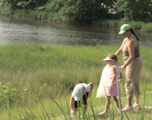
Our Goal
To keep the health and protection of the Rivanna River Watershed
at the forefront of our
community's environmental
agenda.

Slide 4
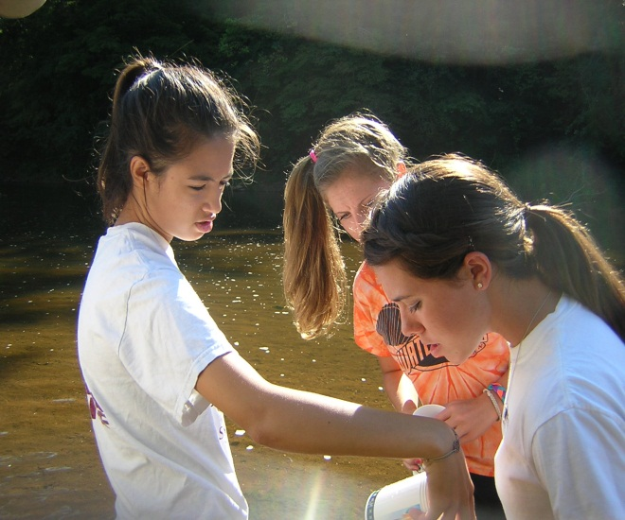
Rivanna Conservation Society
RCS sponsors events and hosts activities throughout the watershed, including river paddles, riverbank and instream clean-ups, public education
forums, teacher and
student education.

Slide 5
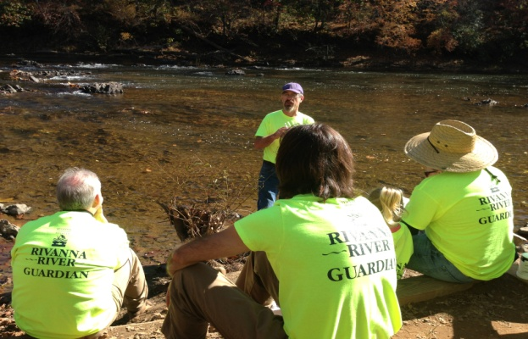
Rivanna River Guardians
In 2013 RCS created the Rivanna River Guardians Program to be the “eyes and ears” of the river. Guardians walk/paddle the River identifying issues of concern, monitor for chemical and bacteria parameters.

Slide 6
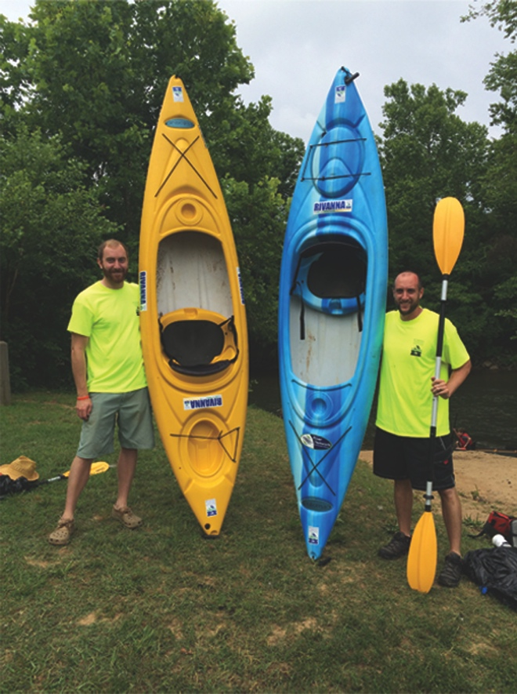
Rivanna River Stewards
The River Stewards program consists of 3 persons who paddle the river on a regular basis to identify problems, locate trash, and share sightings special birds, fish and plants. The Stewards coordinate their activities with those of the Guardians.

Slide 7
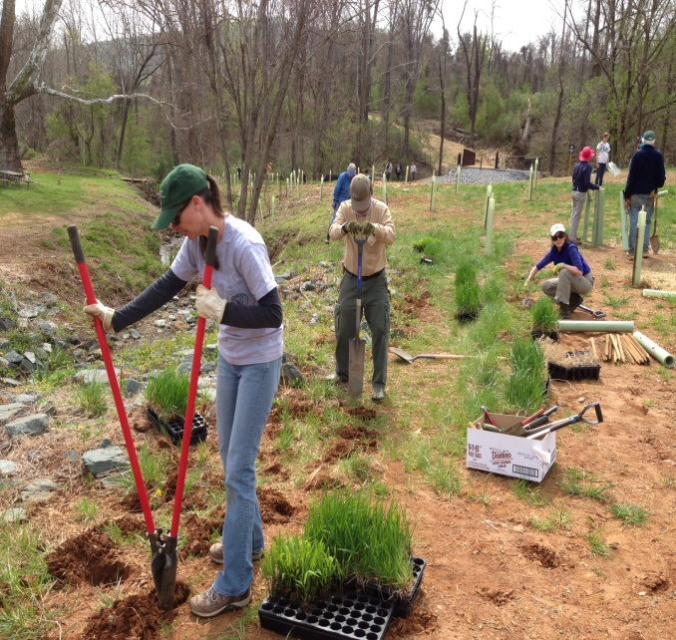
GO X-STREAM MAKEOVER
Primitive and Survival Skills Workshop
Toad, Frog & Night Critters Workshop
2 Buffer Plantings
2 Earth Day Fairs
2 Public Lectures
5 River Cleanups
5 Watershed Flyovers
10 school programs
Rivanna River Sojourn

Slide 8
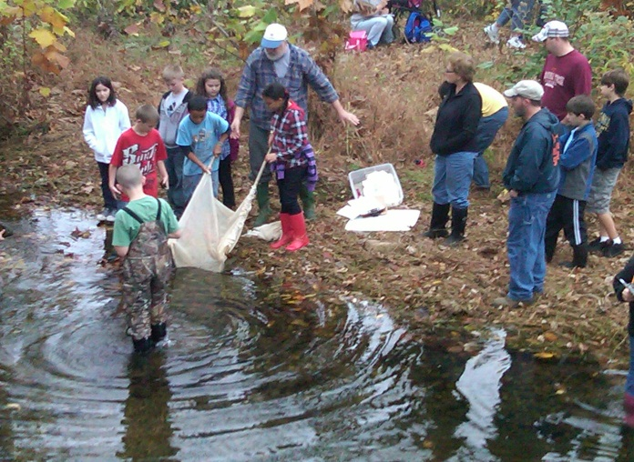
Water Health for the Commonwealth
Water Health for the Commonwealth is the RCS student training program to engage young people in Water Quality Monitoring efforts, Including World
Water Monitoring Day.

Slide 9
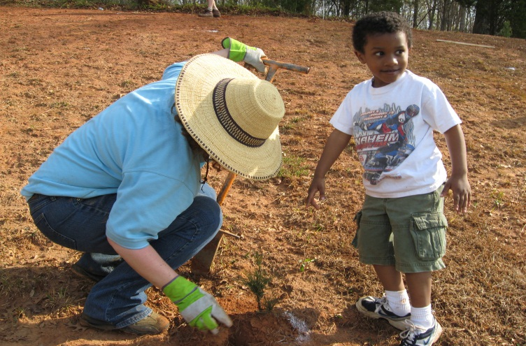
Get Involved!
RCS sponsors events, riparian buffer plantings and watershed restoration projects. As well as the Go X-Stream Rivanna River Makeover.

Slide 10
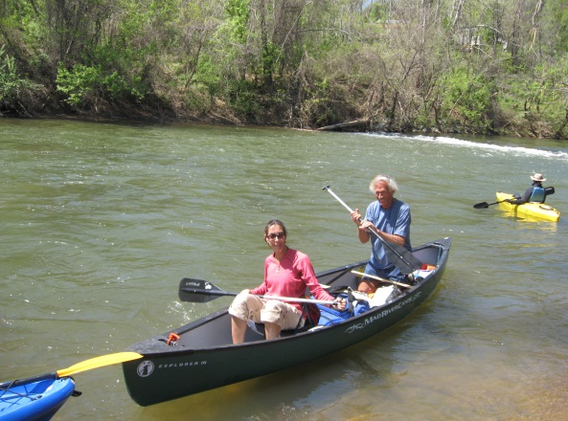
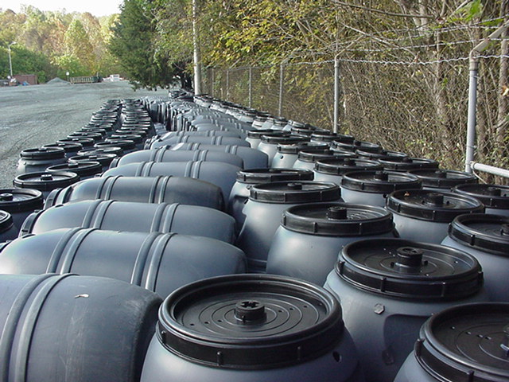
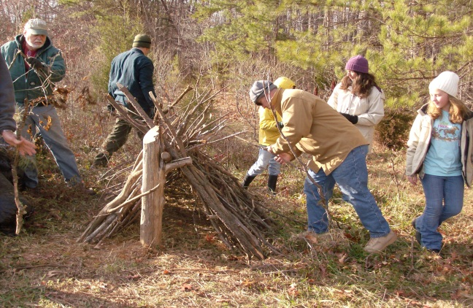
Events with RCS
Annual Rivanna River Sojourn
Rain Barrel Workshops and Sales
Scheier 100 Acre Natural Area in Palmyra

Slide 11
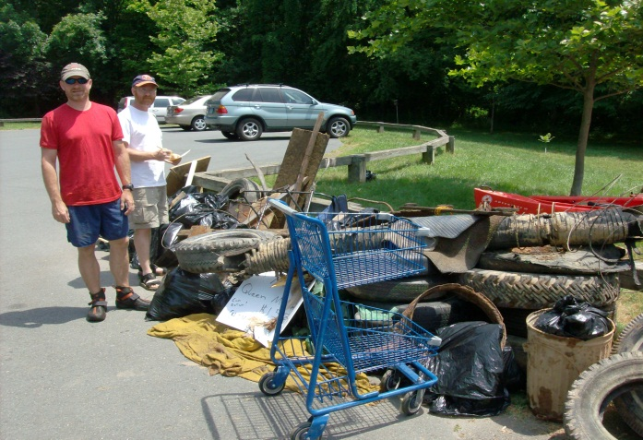
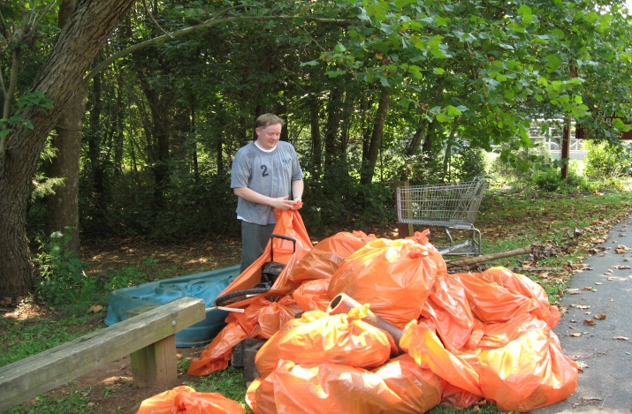
Spring & Fall Rivanna River Cleanups
Third Thursday Brown Bag Lecture Series
Water Health for the Commonwealth

Slide 12
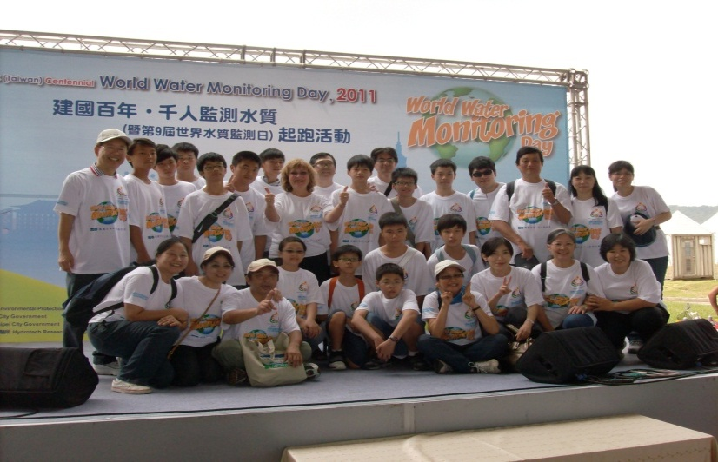
RCS is the regional coordinator of the World Water Monitoring Day (WWMD) program created to link US students with their young people around the world.

Slide 13
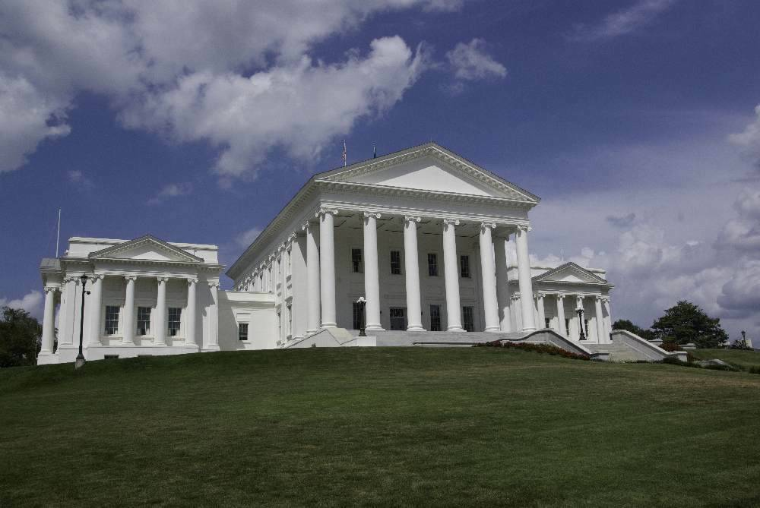
RCS engages in and encourages a continuous dialogue with local, state and federal government officials.

Slide 14
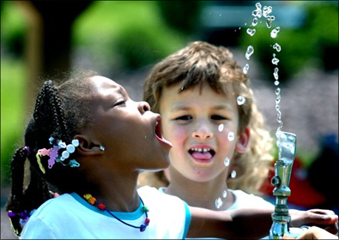
Advocacy
Education
Outreach
Recreation
Restoration

Slide 15
Rivanna Conservation Society
Robbi Savage, Executive Director
exec@rivannariver.org
PO Box 1501
Charlottesville, VA 22902
434 97-RIVER
www.rivannariver.org

