Slide 1
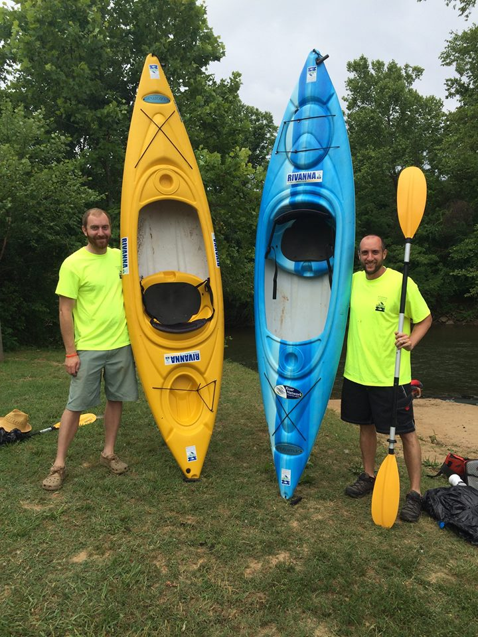
River Steward Program
Eyes and ears of the organization throughout the Rivanna River watershed.
Advocate for conservation, clean water,
environmental/fish restoration, and
species enhancement.
Patrol the river on a regular basis by boat.

Slide 2
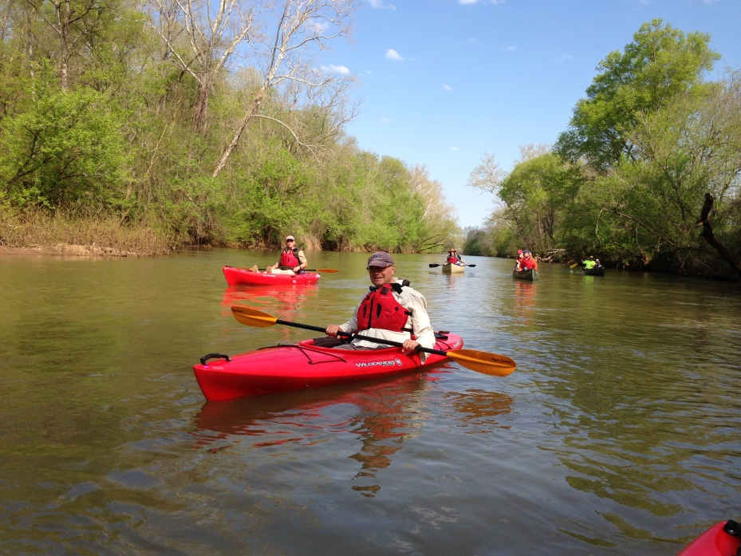
River Steward Program
Help manage and coordinate the data from the River Guardians Corps program.
Lead float trips, service projects,
clean-ups.
Presently two part-time
River Steward employees.

Slide 3
Bank Erosion near Crofton Access Point
Bank Erosion near Crofton Access Point

Slide 4
Pipe Outfall

Slide 5
River Cleanups

Slide 6
Wildlife Sightings

Slide 7
Flora Sightings

Slide 8
Interact with Community Members on the River

Slide 9
Lead Service Projects

Slide 10
Always Interesting Things to See

Slide 12
Community Water Supply?

Slide 13
RIVANNA CONSERVATION SOCIETY PO BOX 1501 CHARLOTTESVILLE, VA 22902 434- 97-RIVER (977-4837) RCS@RIVANNARIVER.ORG

