Slide 1
Water trivia www.rivannariver.org 434-97-RIVER

Slide 2
Animals and Aquatic Life
Rivanna River and Watershed
Stormwater
Water Quality Monitoring
Water Conservation
100
100
100
100
100
200
200
200
200
200
300
300
300
300
300
400
400
400
400
400
500
500
500
500
500

Slide 3
Animals and aquatic life 100
What are the signs of
beaver presence along the
river?
ANSWER

Slide 4
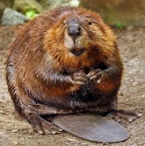
Animals and aquatic life 100 ANSWER
GNAWED TREE TRUNKS;
PEELED + POINTED
BRANCHES/STUMPS

Slide 5
Animals and aquatic life 200
What animal would be found
on the Rivanna River?
Bald Eagle
Alligator
Flamingo
Penguin
ANSWER

Slide 6
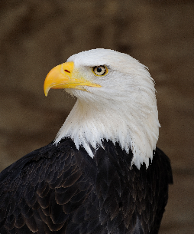
Animals and aquatic life 200 ANSWER
A. BALD EAGLE

Slide 7
Animals and aquatic life 300
Spinymussels are what type of mollusk, meaning that they have two shells held together by ligaments?
ANSWER

Slide 8
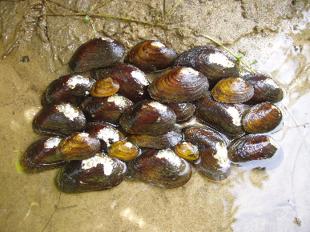
Animals and aquatic life 300 ANSWER
BIVALVE MOLLUSKS

Slide 9
Animals and aquatic life 400
Which tree is not commonly
found along the Rivanna River?
River Birch
Sequoia
Green Ash
American Sycamore
ANSWER

Slide 10
Animals and aquatic life 400 ANSWER
B. SEQUIOA

Slide 11
Animals and aquatic life 500
Which of the following is not a threat
to a decrease in shad population?
People canoeing on the river
Pollution
Dams
Overfishing
ANSWER

Slide 12
Animals and aquatic life 500 ANSWER
PEOPLE CANOEING
ON THE RIVER

Slide 13
Rivanna river and watershed 100
What is another name for the
Rivanna River?
Mr. Washington’s River
Mr. Jefferson’s River
Mr. Madison’s River
Mr. Lincoln’s River
ANSWER

Slide 14
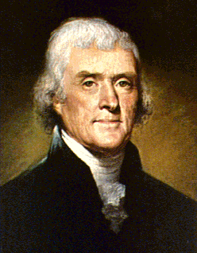
Rivanna river and watershed 100 answer
B. MR. JEFFERSON’S
RIVER

Slide 15
Rivanna river and watershed 200
The Rivanna River originates in
which mountain range?
The Rockies
The Alps
The Blue Ridge
The Smokies
ANSWER

Slide 16
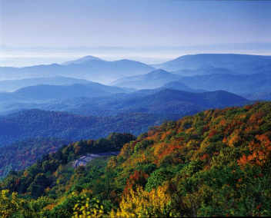
Rivanna river and watershed 200 answer
C. THE BLUE RIDGE

Slide 17
Rivanna river and watershed 300
How much of the Rivanna
Watershed is forested?
20%
40%
65%
94%
ANSWER

Slide 18
Rivanna river and watershed 300 ANSWER
C. 65%

Slide 19
RIVANNA RIVER AND WATERSHED 400
What river/waterbody is the Rivanna a tributary of?
The York River
The James River
The Susquehanna River
The Chesapeake Bay
ANSWER

Slide 20
Rivanna river and watershed 400 ANSWER
B & D
THE JAMES RIVER
AND THE CHESAPEAKE
BAY

Slide 21
Rivanna river and watershed 500
What are the two major threats to
the Rivanna River?
ANSWER

Slide 22
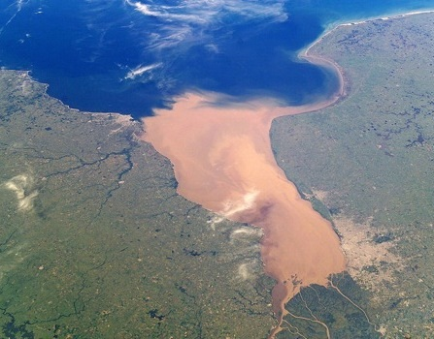
Rivanna river and watershed 500 ANSWER
PATHOGENS (E.COLI)
AND SEDIMENTATION

Slide 23
Stormwater 100
Which of the following is not a
pervious surface?
Loose Gravel
Vegetation
Forests
Sidewalks
ANSWER

Slide 24
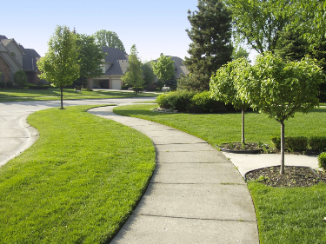
Stormwater 100 Answer
D. SIDEWALKS

Slide 25
STORMWATER 200
Which is not an example of a Best
Management Practice (BMP)?
Rain Barrel
Rain Garden
Impermeable Pavement
Green Roofs
ANSWER

Slide 26
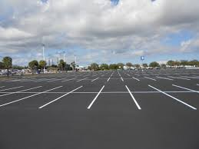
STORMWATER 200 ANSWER
IMPERMEABLE
PAVEMENT

Slide 27
Stormwater 300
How long can rain gardens hold
water?
12 hours
24 hours
36 hours
48 hours
ANSWER

Slide 28
STORMWATER 300 ANSWER
D. 48 HOURS

Slide 29
STORMWATER 400
What is stormwater?
ANSWER

Slide 30
Stormwater 400 ANSWER
WATER FROM A RAIN
EVENT THAT DOES NOT
SOAK INTO THE GROUND

Slide 31
Stormwater 500
What do we call the type of
pollution source you can’t find
the exact location it comes from?
Hint: Opposite of the type where a pipe is pouring out pollution
ANSWER

Slide 32
STORMWATER 500 ANSWER
NON-POINT SOURCE

Slide 33
Water quality monitoring 100
What are three types of water
quality monitoring?
ANSWER

Slide 34
Water quality monitoring 100 ANSWER
CHEMICAL, BACTERIA,
BIOLOGICAL, AND
PHYSICAL
Any 3 of the 4

Slide 35
Water quality monitoring 200
Where do Benthic
Macroinvertebrates live?
On the top of a body of water
In the middle of a body of water
On the bottom of a body of water
Benthic Macroinvertebrates do
not live in water
ANSWER

Slide 36
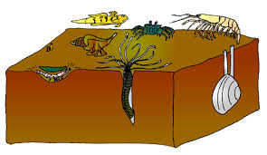
Water quality monitoring 200 ANSWER
C. ON THE BOTTOM OF
A BODY OF WATER

Slide 37
Water quality monitoring 300
Which of the following is not a reason we
measure benthic macroinvertebrates?
They are affected by the physical,
chemical, and biological conditions of
the stream
They may show effects of pollution
They are challenging to monitor
They are important in the food web of
the stream
ANSWER

Slide 38
Water quality monitoring 300 ANSWER
C. THEY ARE
CHALLENGING
TO MONITOR

Slide 39
Water quality monitoring 400
What are the two things we test
for with chemical monitoring?
ANSWER

Slide 40
Water quality monitoring 400 ANSWER
PH
AND
DISSOLVED OXYGEN

Slide 41
Water quality monitoring 500
What is the black and white
circle called we use to
measure turbidity?
ANSWER

Slide 42
Water quality monitoring 500 ANSWER
SECCHI DISK

Slide 43
Water conservation 100
How many gallons of water does
a standard toilet use per flush?
1-3 gallons
2-4 gallons
5-7 gallons
10-12 gallons
ANSWER

Slide 44
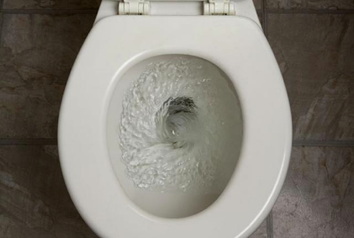
Water conservation 100 answer
C. 5-7 GALLONS

Slide 45
Water conservation 200
When is the best time to water
your garden?
Early in the morning
In the middle of the day
At night
Either A or C
ANSWER

Slide 46
Water conservation 200 answer
D. EITHER A OR C

Slide 47
Water conservation 300
Which type of plant typically
requires less watering?
Native and adaptive plant
Non-native plant and non-
adaptive plant
ANSWER

Slide 48
Water conservation 300 answer
NATIVE AND
ADAPTIVE
PLANT

Slide 49
Water conservation 400
What are some uses for the
water collected by a rain barrel?
ANSWER

Slide 50
Water conservation 400 answer
WASHING THE CAR,
BATHING YOUR DOG,
WATERING THE
GARDEN

Slide 51
Water conservation 500
What percent of the earth’s
water is freshwater, and what
percentage of the human body is
made up of water?
ANSWER

Slide 52
Water conservation 500 answer
3% FRESHWATER (2% OF WHICH IS IN GLACIERS, SO ONLY 1% AVAILABLE)
AND
65-70% OF HUMAN BODY IS MADE UP OF WATER

